Slide 1
5.6 Forwards and Futures
鄭凱允

Slide 2
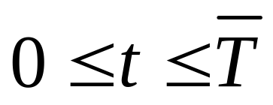

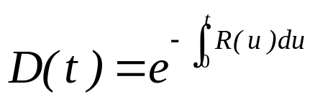
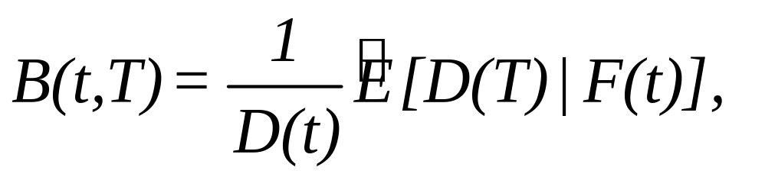
5.6.1 Forward Contracts
Let S(t), , be an asset price process, and let R(t), , be an interest rate process. We consider will mature or expire at or before time of all bonds and derivative securities. As usual, we define the discount process . According to the risk-
neutral pricing formula (5.2.30), the price at time t of a zero-coupon bond paying 1 at time T is
        (5.6.1)

Slide 3



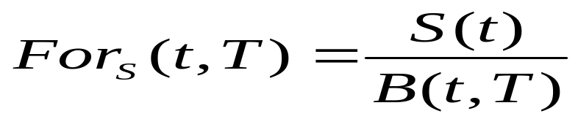
Definition 5.6.1
A forward contract is an agreement to pay a specified delivery price K at a delivery date T, where for the asset whose price at time t is S(t). The T-forward price of this asset at time t where is the value of K that makes the forward contract have no-arbitrage price zero at time t.
Theorem 5.6.2.
Assume that zero-coupon bonds of all maturities can be traded. Then
        (5.6.2)

Slide 4

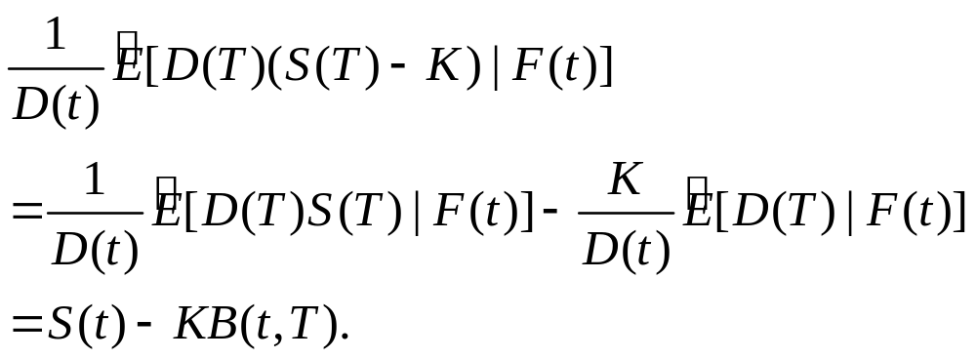
Remark 5.6.3
The proof of Theorem 5.6.2 does not use the notion of risk-neutral pricing. It shows that the forward price must be given by (5.6.2) in order to preclude arbitrage. Indeed, using (5.2.30), (5.6.1), and the fact that the discounted asset price is a martingale under , we compute the price at time t of the forward contract to be
In order for this to be zero, K must be given by (5.6.2)

Slide 5

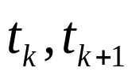
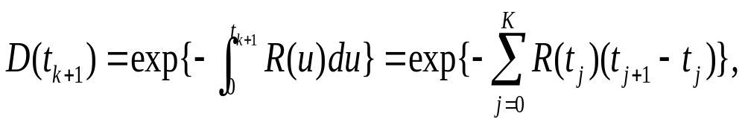

5.6.2 Futures Contracts
Consider a time interval [0,T], which we divide into subintervals using the partition points 0=
We shall refer to each subinterval [ ) as a “day.”
suppose the interest rate is constant within each day. Then the discount process is given by D(0)=1 and, for k=0,1,…,n-1,
which is -measurable.

Slide 6

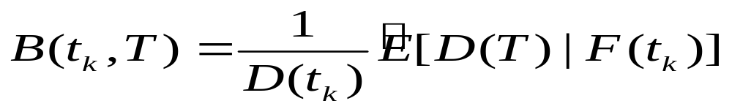
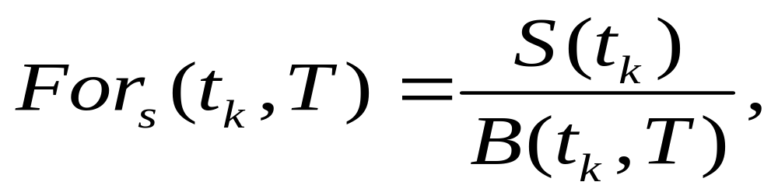
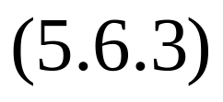
According to the risk-neutral pricing formula (5.6.1), the zero-coupon bond paying 1 at maturity T has time- price
An asset whose price at time t is S(t) has time- forward price
an -measurable quantity.

Slide 7

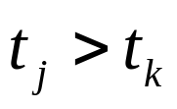
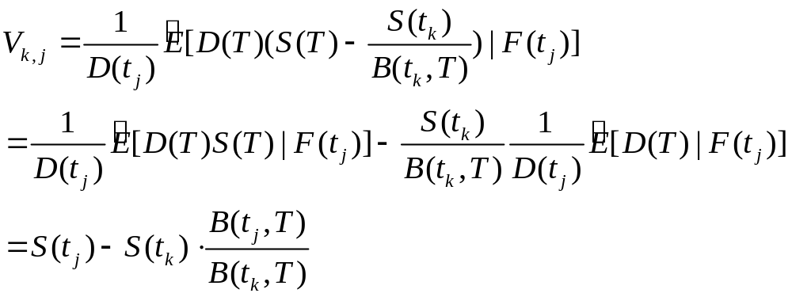
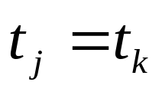
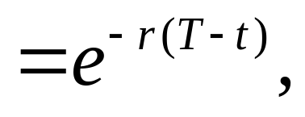
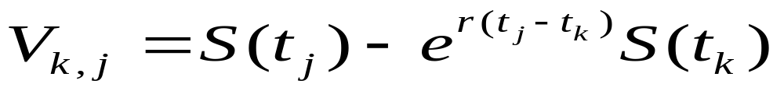
Suppose we take a long position in the forward contract at time . The value of this position at time is
If , this is zero, as it should be. However, for
it is generally different from zero. For example, if the interest rate is a constant r so that B(t,T)

Slide 8
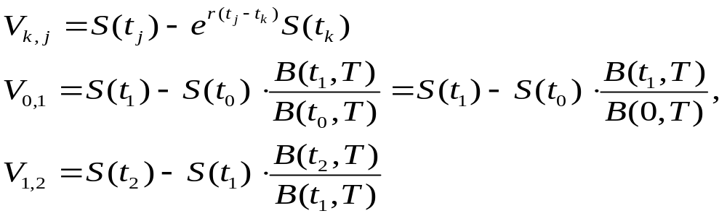
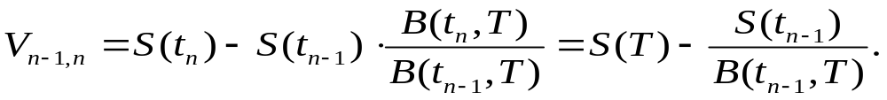
To alleviate to problem of default risk, the forward contract purchaser could generate the cash flow

Slide 9

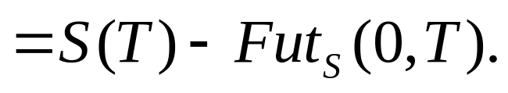
A better idea than daily repurchase of forward contracts is to create a futures price .
The sum of payments received by an agent who purchases a futures contract at time zero and holds it until delivery date T is

Slide 10


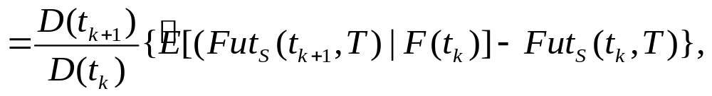


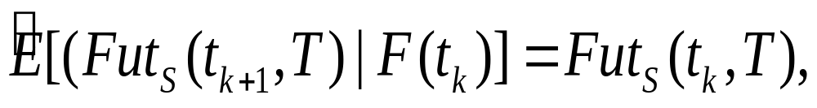


The condition that the value at time of the payment to be received at time be zero may be written as
Where we have used the fact that is -measurable to take out of the conditional expectation. From the equation above, we see that

Slide 11
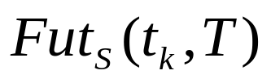


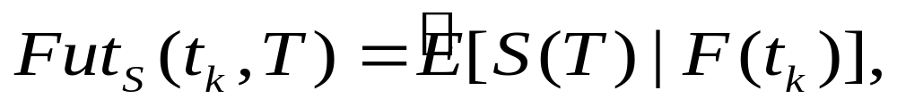



This shows that must be a discrete-time martingale under . But we also require that ,from which we conclude that the futures prices must be given by the formula
Indeed, under the condition that , equations (5,6,4) and (5,6,5) are equivalent.

Slide 12



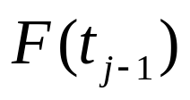

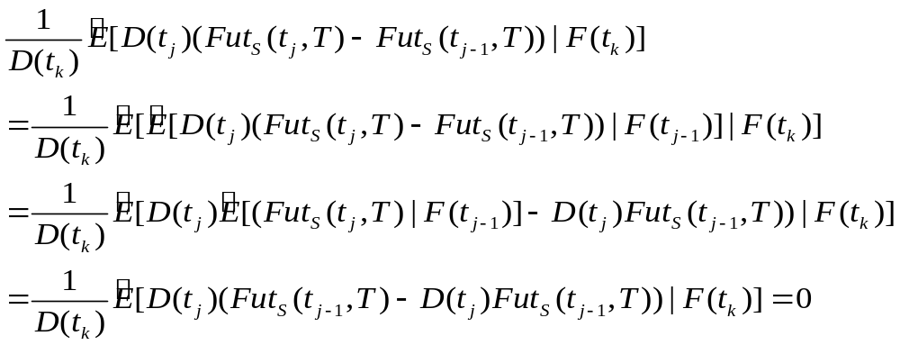
We note finally that with given by (5.6.5), the value at time of the payment to be received at time is zero for every . Indeed, using the -measurability of and the martingale property for , we have

Slide 13
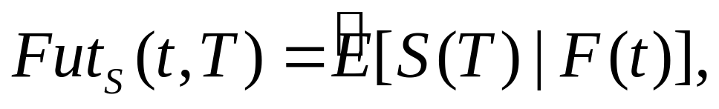




Definition 5.6.4
The futures price of an asset whose value at time T is S(T) is given by the formula
Theorem 5.6.5
the futures price is a martingale under the risk-neutral measure , it satisfies , and the value of a long (or a short) futures position to be held over an interval of time is always zero.

Slide 14

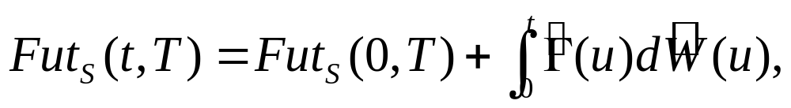

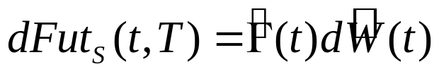
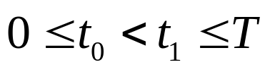



If the filtration F(t), , is generated by a Brownian motion W(t), , then Corollary 5.3.2 of the Martingale Representation Theorem implies that
for some adapted integrand process (i.e., ). Let be given and consider an agent who at times t between times and holds futures contracts.

Slide 15
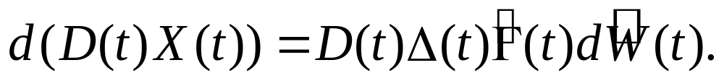




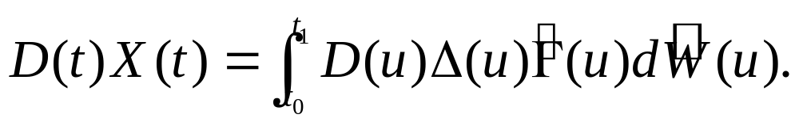

The interest rate is R(t) and the agent’s profit X(t) from this trading satisfies
And thus
assume that at time the agent’s profit is
At time , the agent’s profit will satisfy

Slide 16
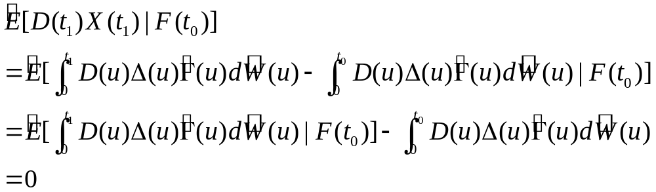


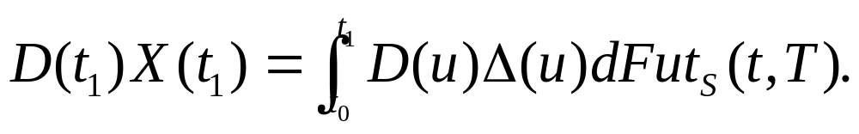

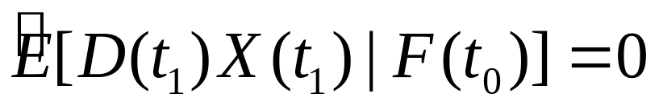
Because Ito integrals are martingales , we have
If the filtration F(t), , is not generated by a Brownian motion, so that we cannot use Corollary 5.3.2, then we must write (5.6.7) as
This integral can be defined and it will be a martingale. We will again have

Slide 17


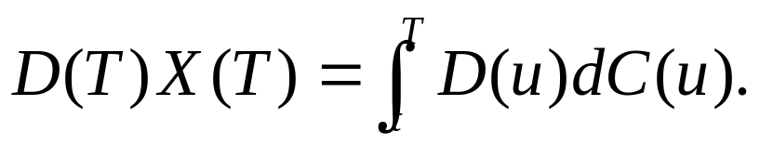
Remark 5.6.6 (Risk-neutral valuation of a cash flow).
suppose an asset generates a cash flow so that between times 0 and u a total of C(u) is paid, where C(u) is F(u)-measurable. Then a portfolio that begins with one share of this asset at time t and holds this asset between times t and T, investing or borrowing at the interest rate r as necessary, satisfies
or equivalently
Suppose X(t)=0. Then integration shows that

Slide 18
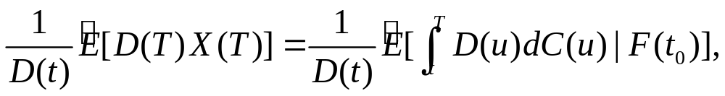






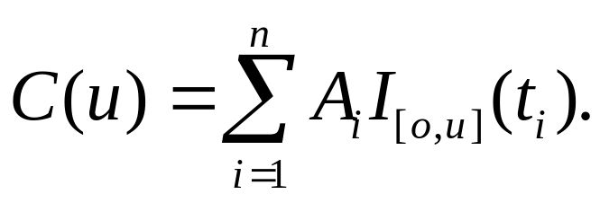
the risk-neutral value at time t of X(T), which is the risk-neutral value at time t of the cash flow received between times t and T, is thus
In (5.6.10), the process C(u) can represent a succession of lump sum payments
at times , where each is an -measurable random variable. The formula for this is

Slide 19
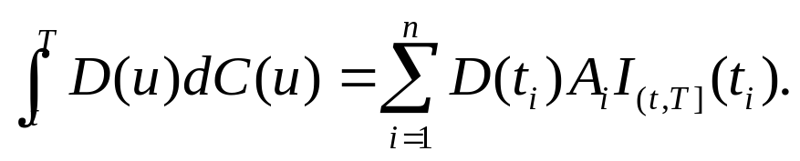
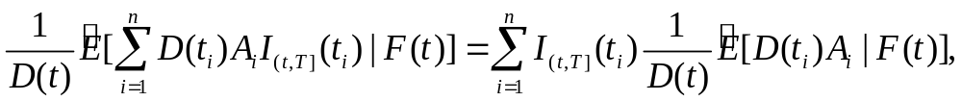
In this case,
only payments made strictly later than time t appear in this sum. Equation (5.6.10) says that the value at time t of the string of payments to be made strictly later than time t is

Slide 20

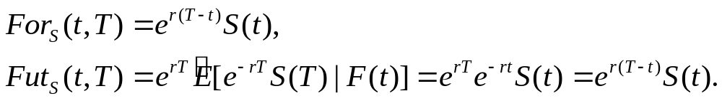


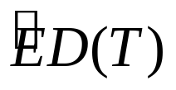
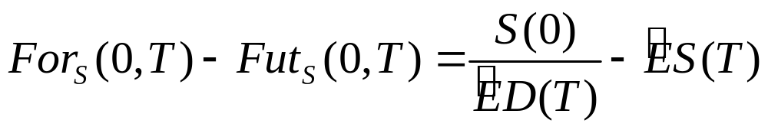
5.6.3 Forward-Futures Spread
If the interest rate is a constant r , then B(t,T)=
and
we compare and in the case of a random interest rate. In this case, B(0,T)= , and the so-called forward-futures spread is

Slide 21
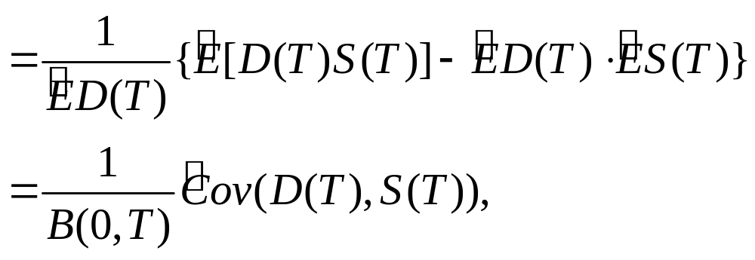

If the interest rate is nonrandom, this covariance is zero and the futures price agrees with the forward price.

